Slide 1
Ultrasound Probe Disinfection
Changing Times
Changing Practices …
Kellie Drake, RN, MBA, CNOR(E)
Infection Prevention Clinician
Wentworth-Douglass Hospital
Kellie.Drake@WDHospital.org

Slide 2
Wentworth Health Partners Joint Commission Survey 2017
2 offices performing fine needle aspiration procedures
Using probe covers for the procedures
Low level disinfecting the probes after the procedures
Surveyor asked for manufacturer’s instructions….
Notes:
The offices were using probe covers appropriately and low level disinfecting probe with hospital approved PDI wipes or T-spray.

Slide 3
GE Manufacturer’s Instructions
GE Transducer Cleaning and Disinfection Guidelines
“If the possibility of cross-contamination or exposure to unhealthy or non-intact skin exists, then high-level disinfection should be performed.”
Notes:
The CDC defines non-intact skin as areas of the skin that have been opened by cuts, abrasions, dermatitis, chapped skin, and so forth.

Slide 4
CDC: Guidelines for Disinfection and Sterilization in Healthcare Facilities 2008
“While use of the probe cover could be considered as changing the category, this guideline proposes use of a new condom/probe cover for the probe for each patient, and because condoms/probe covers can fail ^{195, 197-199}, the probe also should be high-level disinfected.”

Slide 5
Society of Diagnostic Medical Sonography
Guidelines for Infection Prevention and Control in Sonography: Reprocessing Ultrasound Transducers
The nature of the procedure determines the transducers Spaulding Classification.

Slide 6
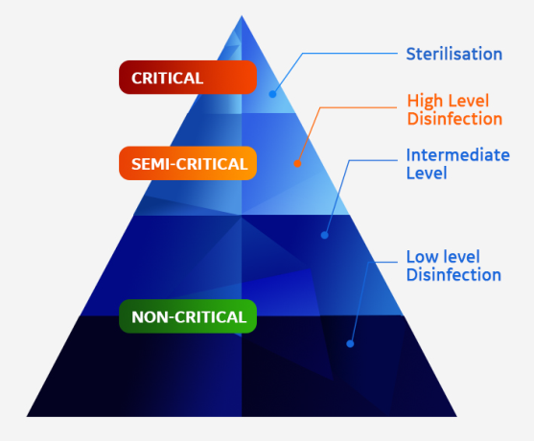
Spaulding Classification
CRITICAL: A device that may come into contact with sterile tissue should sterile. Such devices should minimally be sterilized. In the case of ultrasound probes, high-level disinfection is acceptable if a sterile cover is used.
Sterilization: All viable microorganisms must be destroyed.
SEMI-CRITICAL: A device that may come into contact with intact mucous membranes and does not ordinarily penetrate sterile tissue. These devices should minimally receive high level disinfection.
High Level Disinfection: All viable microorganisms must be destroyed, except a small number of bacterial spores.
NON-CRITICAL: Devices that do not ordinarily contact the patient or contacts only intact skin. These devices should be low level disinfected.
Low level Disinfection: Most vegetative bacteria and viruses destroyed, except bacterial spores, mycobacteria, fungi, or small non-lipid viruses.

Slide 7
Spaulding Classification for Ultrasound Transducers
Spaulding Classification | Intended Use | Example Procedures | Minimum Disinfection/ Sterilization Level Required
Critical | Risk of transducer contact with sterile tissues | Ultrasound-guided intraoperative or vascular access procedures, drainage, open wounds | Sterilization or HLD
Semi-critical | Risk of transducer contact with mucous membranes or non-intact skin | Endocavitary, biopsy, or invasive procedures, venous or arterial placement procedures, scans over partially healed wounds or non-intact skin | HLD
Non-critical | Transducer only contact intact skin | Surface scans intact skin | LLD

Slide 8
Gap Analysis
Biomed/Medical Engineering
Report listing ultrasound units and individual probes in the organization
Department and Practice Management Team
Verify information on report
What types of procedure and volume?
How do they function?
Disinfection
Products on the market: OPA or Trophon
What guidelines are we following?
Notes:
Engaged Biomed to supply us with a list of all ultrasounds and probes logged into our asset inventory.
Development of spreadsheet to compile information:
department, contact person, manufacturer, model, transducers, procedures, volume & frequency of use.
Martha was instrumental in setting up meetings with the key stakeholders in the development of our new process.
The department and office managers needed to complete the information on the spreadsheets so we could verify we had a complete list of equipment.
It was very important to engage our staff. Did one-on-one interviews with front line staff to understand their daily workflow. This would drive the development of our new practices.

Slide 9
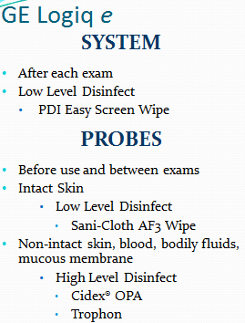
Gap Analysis and Implementation
Process Centralized or Decentralized
Purchase of Trophon or additional probes
Location for units
Responsibility for Reviewing IFU
Designate individual person or
individual department’s responsibility
Cleaning Cards
Notes:
Materials setting up the supplies to order for the Trophons. Took time for the products to get set up.
Made cleaning card to help staff and to identify which ultrasounds were accounted for and researched.
Not all probes can be HLD with the Trophon: looked to see if we could switch out the probes or do we need to implement a process to get to SPD GUS station.

Slide 10
Implementation
Materials Department
Supplies
Disinfection wipes
Education
ED/OD Department: competency development and coordination of training
Nanosonics University
Development of Resource staff
Documentation
Trophon log book vs. own book
Policy
Auditing

Slide 11
Reassessment
Log book
Trophon vs. Own
Resources for log book
Ultrasound Management
Biomed and Materials Departments
Education
Follow-up and yearly education
Probe placement, documentation, AAMI regs
Probe Maintenance
Repair/Replacement issues
Notes:
Log: moved from trophon log book to our own documentation. Had some issue with incomplete documentation because of differences in each department.
Some departments HLD when necessary others keep probes disinfected all the time
Ultrasound department documents a bit different, did carve out for them.

Slide 12
References
GE Healthcare: https://www.gehealthcare.com/-/media/a7e6ae09830e42bd980e563910c953cf.pdf
CDC, Guidelines for Disinfection and Sterilization in Healthcare Facilities, 2008, https://www.cdc.gov/infectioncontrol/guidelines/disinfection/
Society of Diagnostic Medical Sonography, Guidelines for Infection Prevention and Control in Sonography: Reprocessing Ultrasound Transducers
American Journal of Infection Control, Ultrasound probe use and reprocessing: Results from a national survey among U.S. infection preventionist, 46 (2018) 913-20. file:///R:/Infection%20Prevention/Ultrasound%20Information/AJIC%20article.pdf

